Slide 1
Input and Output Function

Slide 2
C programming has several in-built library functions to perform input and output tasks.
The input/output functions are classified into two types
Formatted I/O functions
Unformatted I/O functions

Slide 3
Formatted I/O functions
Two commonly used functions for formatted I/O (Input/Output) are printf() and scanf().
The scanf() function reads formatted input from standard input (keyboard) whereas the printf() function sends formatted output to the standard output (screen).

Slide 4
printf() function
The printf() function is used for output. It prints the given statement to the console.
The syntax of printf() function is given below:
printf("format string",argument_list);
The format string can be %d (integer), %c (character), %s (string), %f (float) etc.

Slide 5
Printf modifiers
%[flag][width][precision][size]conversion character
Width modifier
specifies the width of the output
Example
int a=10;
printf("\n%d",a);//
printf("\n%d",12);
printf("\n%10d",12);

Slide 6
Example 1
#include<stdio.h>
void main()
{
int num1 = 10;
float num2 = 9.23;
printf("num1 = %d\n",num1);
printf("num1 = %5d\n",num1);
printf("num1 = %10d\n",num1);
printf("num2 = %f\n",num2);
printf("num2 = %12f\n",num2);
}

Slide 7
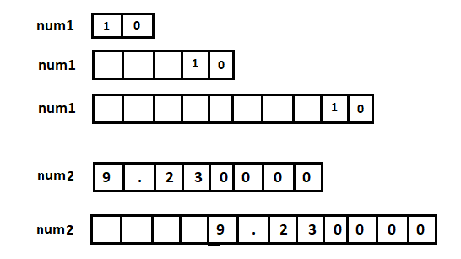

Slide 8
Precision
Specifies the width after the decimal point
Example
printf("\n%.3f",b);
printf("\n%7.2f",b);
Size modifier
h for short int
l for long int
ll for long int
L for long double

Slide 9
Example 2
#include<stdio.h>
int main()
{
short int n1 = 10;
long int n2 = 100000;
long long int n3 = 5060626500325;
long double n4 = 556626.36595;
printf("n1 = %hd\n",n1);
printf("n2 = %ld\n",n2);
printf("n3 = %lld\n",n3);
printf("n4 = %Lf\n",n4);
return 0;
}

Slide 10
Flag modifier
The flag modifier allows one or more print modifications to be specified. The flag can be any one of the characters from the below.
(- minus): left justify
(+ plus):prepends a plus for positive values
Space: prepends space for positive values
(0 zero): with width, prepends zero for numeric types
#: different advantages (hexadecimal,octal)
Example
printf("\n%010d",12);

Slide 11
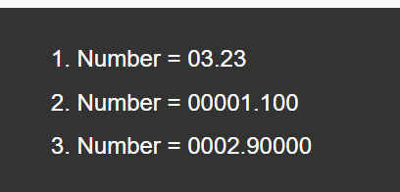
Example 3 Pad with leading zeros
#include<stdio.h>
int main()
{
printf("1. Number = %05.2f\n",3.23);
printf("2. Number = %09.3f\n",1.1);
printf("3. Number = %010.5f",2.9);
return 0;
}

Slide 12
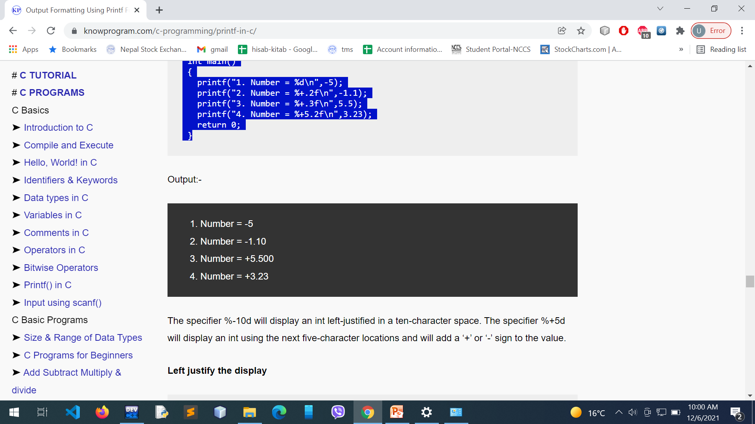
Example 4 Display sign of the value
#include<stdio.h>
int main()
{
printf("1. Number = %d\n",-5);
printf("2. Number = %+.2f\n",-1.1);
printf("3. Number = %+.3f\n",5.5);
printf("4. Number = %+5.2f\n",3.23);
return 0;
}

Slide 13
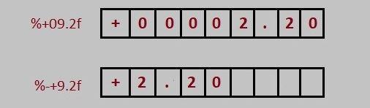
Example 5
#include<stdio.h>
void main()
{
// without flag 0
printf("Number = %+09.2f\n",2.2);
// with flag -
printf("Number = %-+9.2f\n",2.2);
}

Slide 14
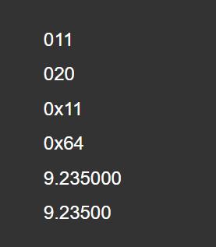
Example 6
#include<stdio.h>
int main()
{
printf("%#o \n",9);
printf("%#o \n",16);
printf("%#x \n",17);
printf("%#x \n",100);
printf("%#f \n",9.235);
printf("%#g \n",9.235);
return 0;
}

Slide 15
Example 7
#include<stdio.h>
#include<conio.h>
void main()
{
int a=19;
float b=18.5;
printf("\n%d",a);
printf("\n%d",12);
printf("\n%10d",12);
printf("\n%010d",12);
int m=1256;
printf("\n%d",m);
printf("\n%o",m);
printf("\n%x",m);
printf("\n%-5d",m);
printf("\n%.3f",b);
printf("\n%7.2f",b);
printf("\n%09.2f",b);
getch();
}

Slide 16
Example 8
#include<stdio.h>
void main()
{
int a;
a=printf("hello");
printf("\nvalue return from printf is %d",a);//5
a=printf("\nhello world");
printf("\nvalue return from printf is %d",a);//12
}

Slide 17
scanf() function
The scanf() function is used for input. It reads the input data from the console.
scanf("format string",argument_list);

Slide 18
Unformatted I/O functions
Unformatted functions do not allow the user to read and display data in desired format.
These library functions basically deal with a single character or a string of characters.
The functions are
getchar()
putchar()
gets()
puts()
getch()
getche()
putch()

Slide 19
Reading and writing a single character
#include<stdio.h>
void main()
{
char ch1,ch2;
printf("Enter two characters");
ch1=getchar();
ch2=getchar();
printf("\nthe two characters are :");
putchar(ch1);
printf("\t");
putchar(ch2);
}

Slide 20
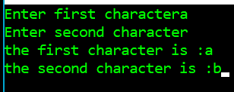
Example of getch, getche, and putch
#include<stdio.h>
void main()
{
char ch1,ch2;
printf("Enter first character");
ch1=getche();
printf("\nEnter second character");
ch2=getch();
printf("\nthe first character is :");
putch(ch1);
printf("\nthe second character is :");
putchar(ch2);
}

